Slide 1

SPOTRA
EID 101:D Connected Devices

Slide 2
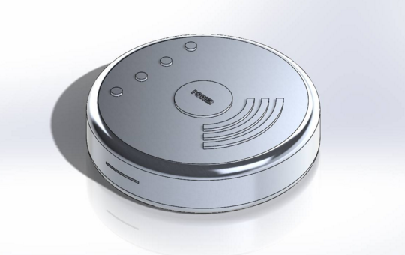
SPOTRA?
HOTSPOT + TRAVEL
Transport
Travel
Transit

Slide 3
WEBSITE

Slide 4
PLAN

Slide 5

1. JFK Int’ Airport

Slide 6
WHY?
Identified
Customer Segment
Value Proposition
Confirm Demand
Introduce ourselves
Contact Information

Slide 7
2. Video/Kickstarter

Slide 8
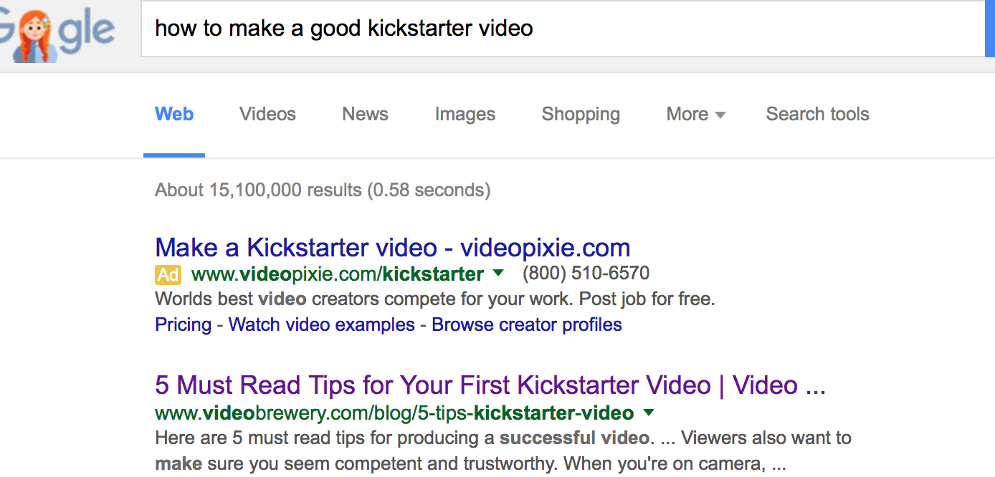

Slide 9
“explain how he was able to use Kickstarter to raise over $300,000 from nearly 5,000 backers. “

Slide 10
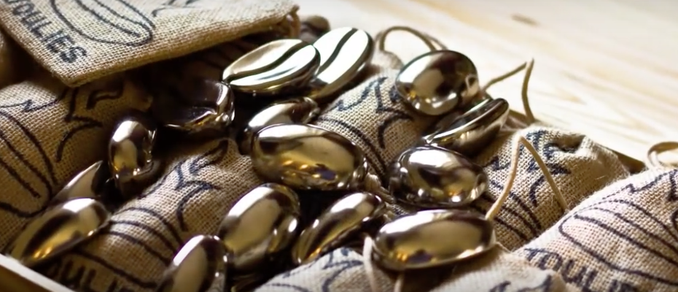

Slide 11
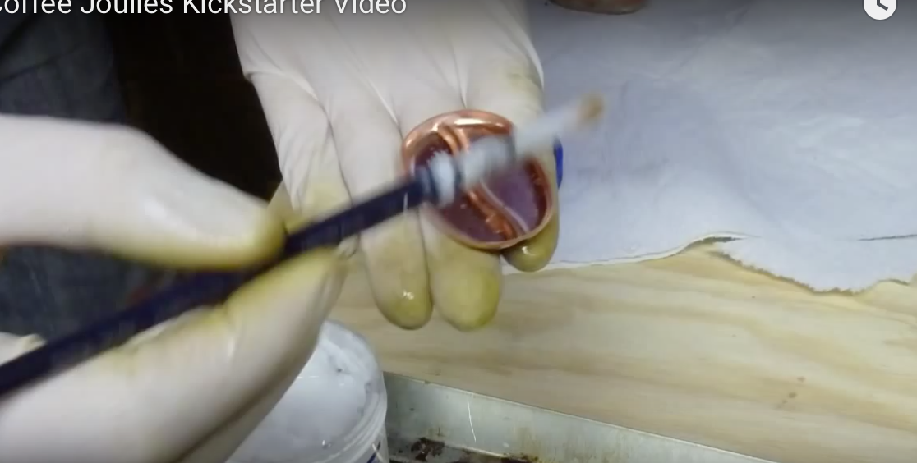

Slide 12
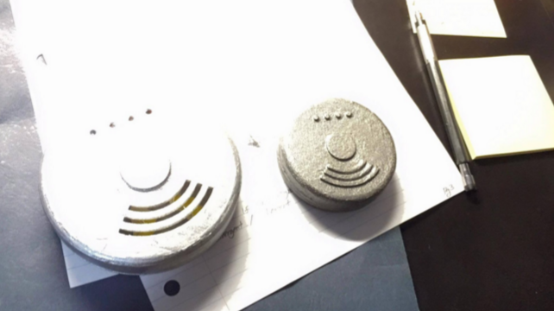
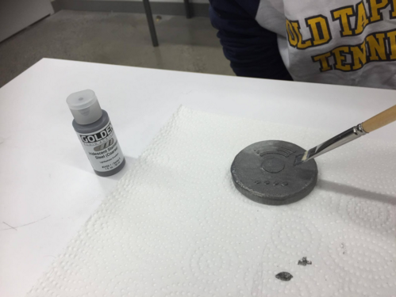

Slide 13
Price Range
Ordering Hotspot
Rental Service

Slide 14
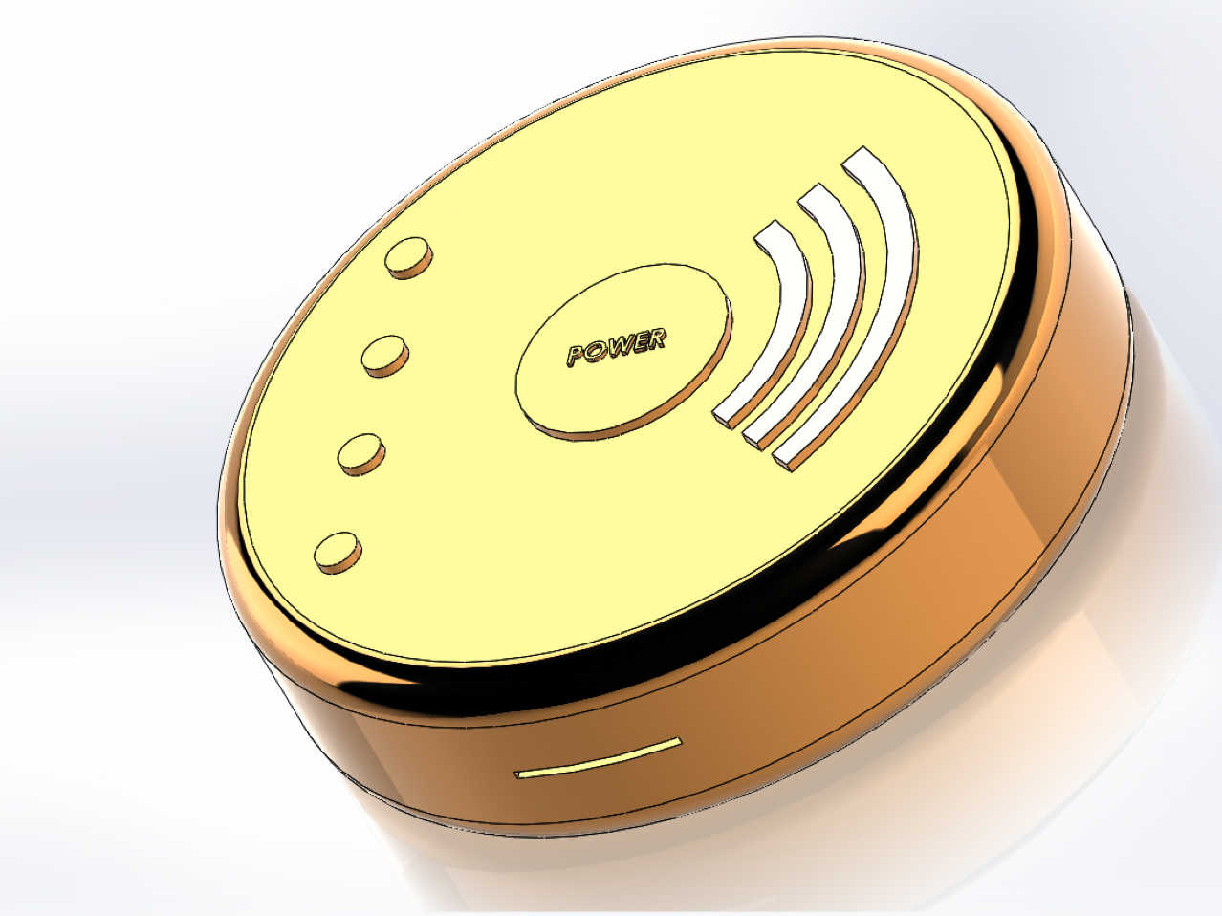
Thank you

